Slide 1
Starter
Complete the following ;
  Topic 24– worksheet 1

Slide 2
Topic 27
Emerging Technologies

Slide 3
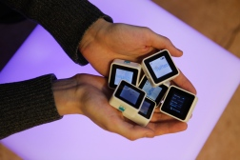
Emerging Technologies
We are always inventing new things and modifying old things to make them better
Microprocessors are becoming smaller & faster, so more and more processing power can be packed into ever smaller spaces requiring less power to work

Slide 4
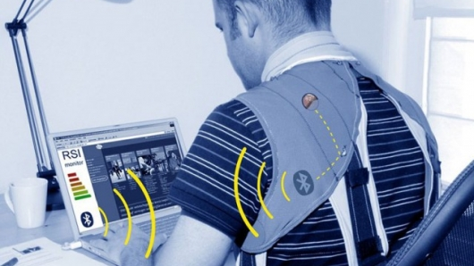
Emerging Technologies
A direct result is that materials are being produced with processors incorporated into the material itself, which may lead to;
Fabrics that can change colour or respond to the surroundings like a chameleon
Materials that can predict their own destruction
Tiny engines that can enter the bloodstream and help fight infection
Clothing that has mobile phone or organiser built into it

Slide 5
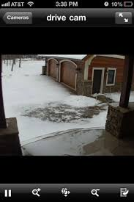
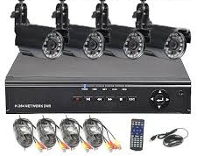
Emerging Technologies
In The Home
Walls that glow, replacing electric lights
Windows that darken as night falls
Door locks with no keys, but that recognise those that live in the house
Surveillance systems that allow us to watch our house using a mobile phone or computer even when on holiday
Devices that feed the pets or control heating or lighting automatically
Televisions or computers becoming one single device, and possibly forming one or more walls of your sitting room
3D TV
Virtual reality computer games that give
whole body experiences
Could pass thoughts replace the password?

Slide 6
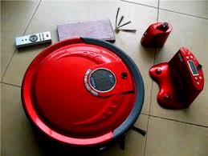
Emerging Technologies
In The Home
Advantages | Disadvantages
Houses become more efficient and cheaper to run | Humans depend on machines too much and forget how to think for themselves
Homes become more comfortable to live in | Humans become lazy
Cleaning is done automatically | Too much surveillance means we lose all our privacy

Slide 7
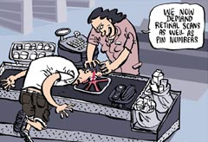
Emerging Technologies
In The School
Biometric data for registration – retina scanning as you enter or leave school
Electronic pads instead of books to read and write your answers
Speaking your answers to the computer instead of writing anything down
Replacing teachers or even schools with computers that you access from home
School dinners that are dispensed according to your vitamin and calorie requirements on that day
Learning helmets that automatically shape your
brains to understand the latest work
Virtual reality experiences in the classroom to make
lessons more exciting

Slide 8
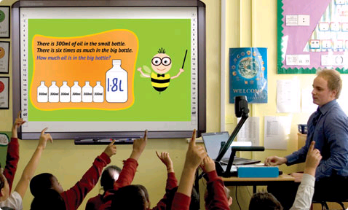
Emerging Technologies
In The School
Advantages | Disadvantages
Learning is more exciting | Learning becomes a passive activity and so becomes boring
You learn more and do not forget anything | With no schools there is little chance to socialise
Examinations become a thing of the past | Teachers and other people employed to run a school will lose their jobs

Slide 9
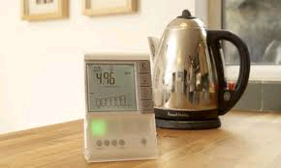
Emerging Technologies
In The Environment
Smart meters in houses mean more efficient use of electricity, oil, gas & water
Electric cars give off lower emissions than petrol or diesel powered cars
Personal computers worn like a bracelet or necklace, or even an earing, constantly monitoring our carbon emissions and suggest alternative actions
ICT devices become organic rather than inorganic, so less dangerous metals will pollute the world
when they are thrown away

Slide 10

Emerging Technologies
In The Environment
Advantages | Disadvantages
The world becomes a cleaner and less dangerous place | The world becomes more polluted with the ceaseless need to produce more, and replace old, ICT devices
We become more aware of our effect on the environment and so make an effort to be “greener” because of various sensors and meters | If, for some reason, something goes wrong, ICT controlled factories or nuclear power stations can lead to environmental disasters such as at the Chernobyl nuclear facility in the Ukraine
ICT devices are made with recycling in mind making less throw-away waste

Slide 11
Activity
Open the Folens Interactive Resources
Complete the following;
Topic 27 Interactive Activity 1
Topic 27 Interactive Activity 2

Slide 12
Homework
Complete the following for homework ;
Topic 27 – Multiple choice questions

